Slide 1
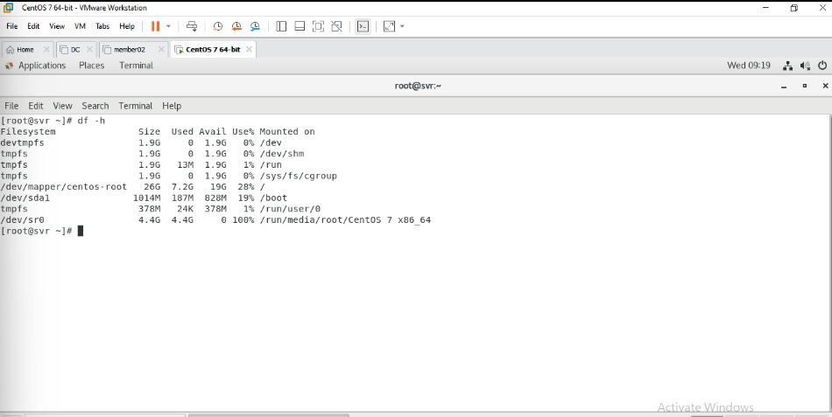
Day 4 Linux
Add cd/dvd –go to setting the go to cd dvd add it then go to terminal ad check it out:-

Slide 2
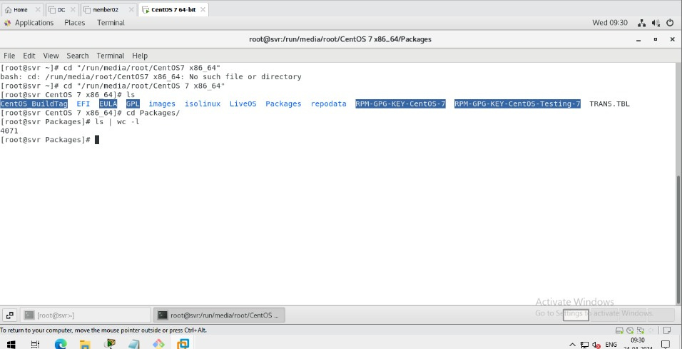
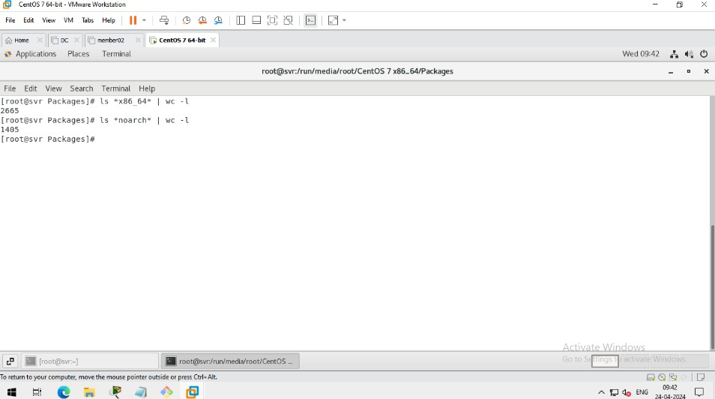
•Check CentOS packaged and how many packages installed :-
•check centos files and how many files:-

Slide 3
Check list of the package that can only installed on 64bits and architechture in linux:-

Slide 4
-Install -update -query/info - uninstalling
Package manager:-
RPM:- -redhat package ,anager. –default pm in centos, -redhatos use for offline installation
YUM:- Yellowdog update manager / Yellowdog updater Modifier its a part of centos & redhat OS. Used for offline installation & online installation

Slide 5
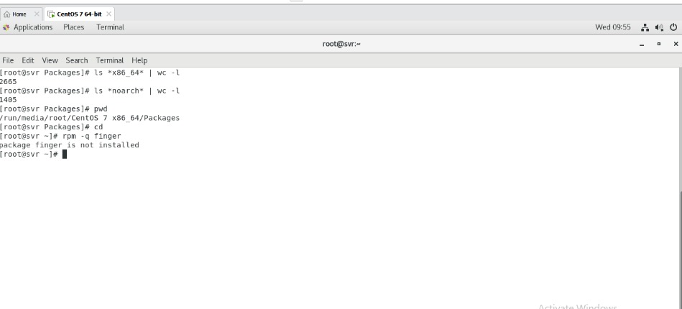
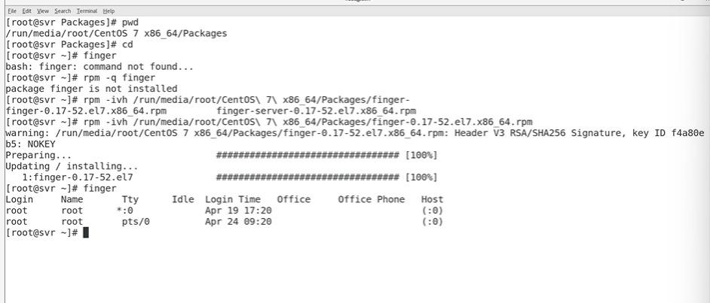
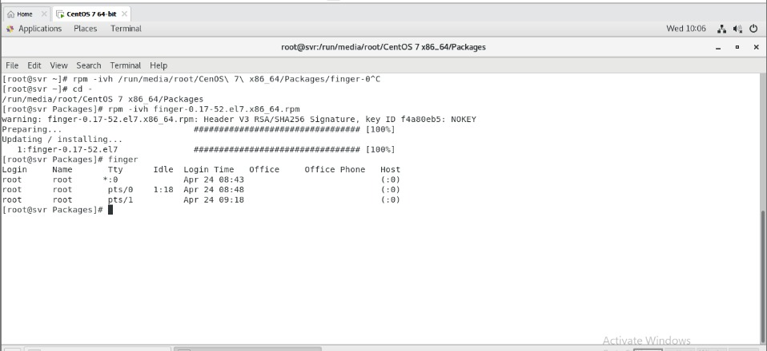
APT:- -Advance Packaging Tool used in Ubuntu, -Kali and Backtrack OS.
DPKG:-Debian packaging Kali,
-. Backtrack OS.
DNF:-
its part of RHEL 8,
CentOS8.full form is Dandified YUM

Slide 6
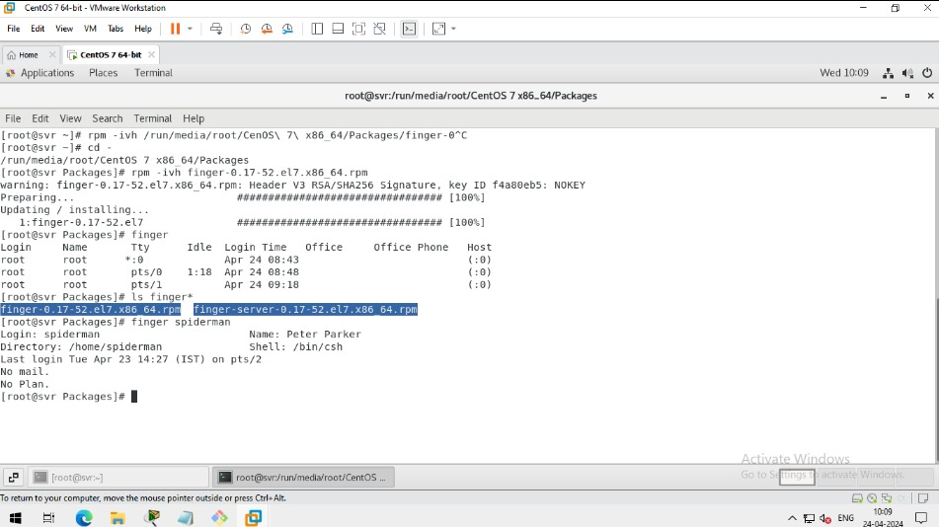
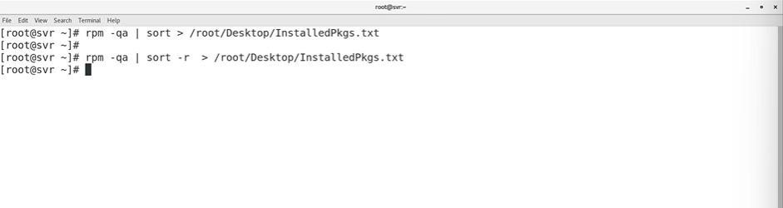
Using finger command to check details:-

Slide 7
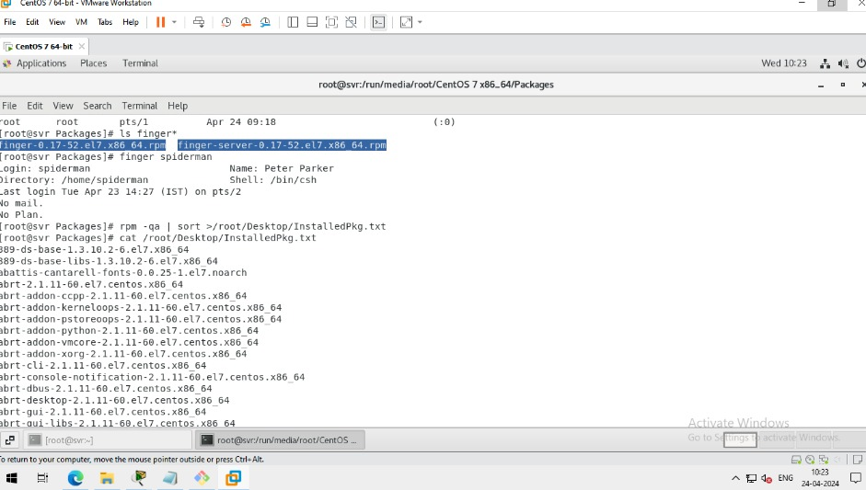
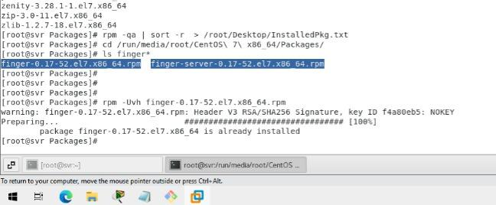
Install the files and Check Upgrade and installing the packages:-

Slide 8
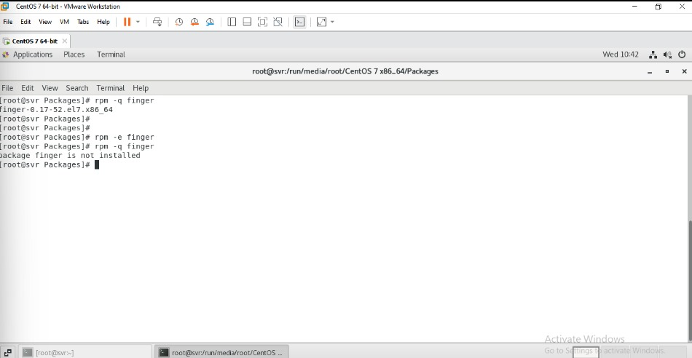
Uninstalled the packages :-

Slide 9
Installing the package online:- ----------------------------------------- -RHN(redhat network ) -RHN satellite server (paid) – production solution -Mirror server in CentOS -online server to install pkgs free.
How to used it:-
---------------------
-Installing in yum server.
Go to root server and put the command
- yum install finger -y

Slide 10
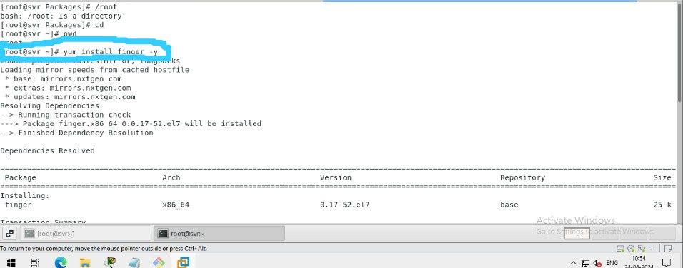
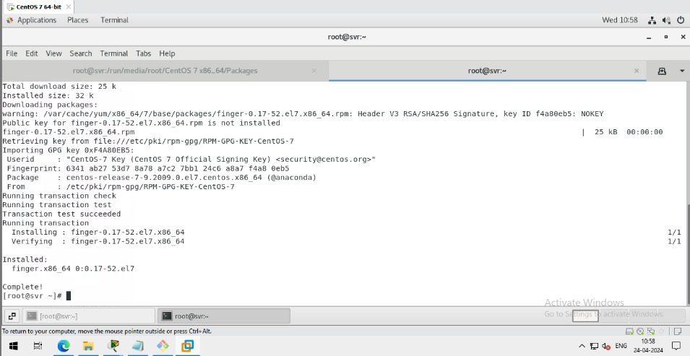

Slide 11
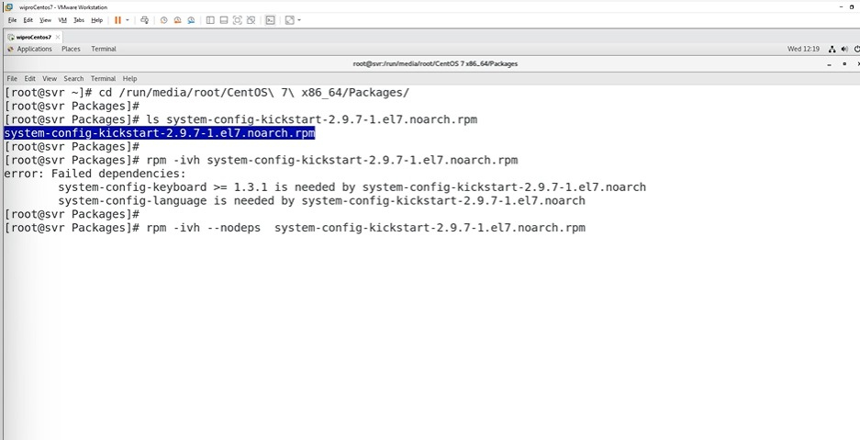
Dependency of Rpm:- -------------------
Yum installing

Slide 12
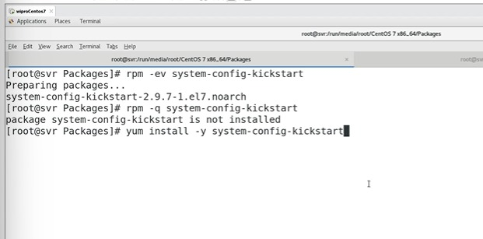

Slide 13
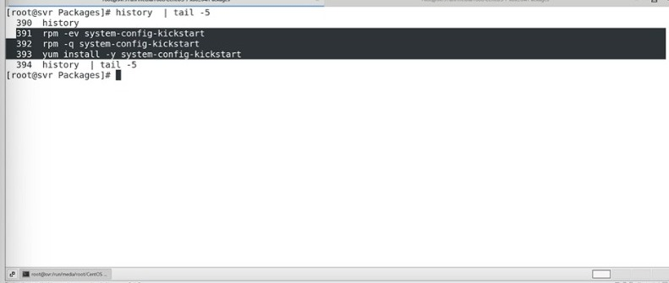
Type this 3 commands to install uninstall and check

Slide 14
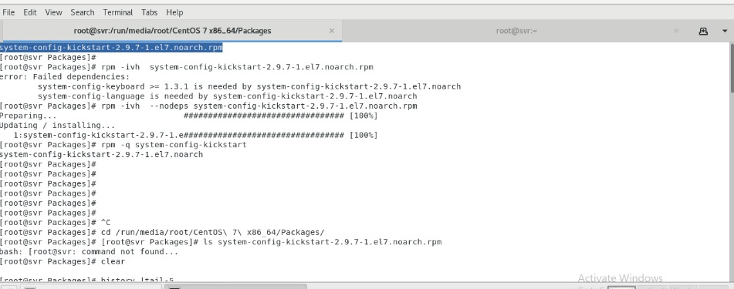
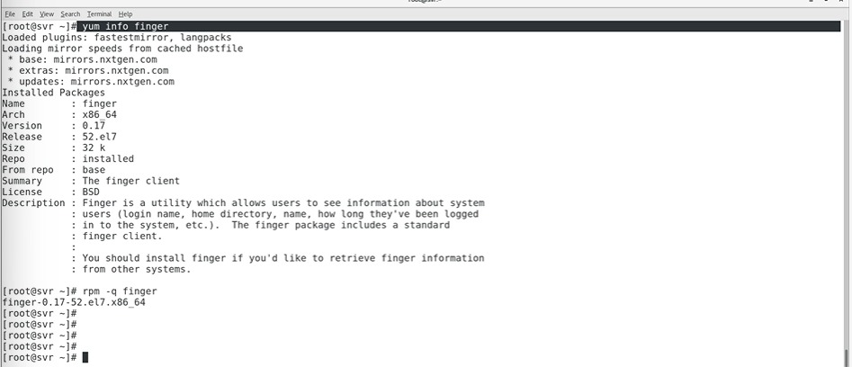
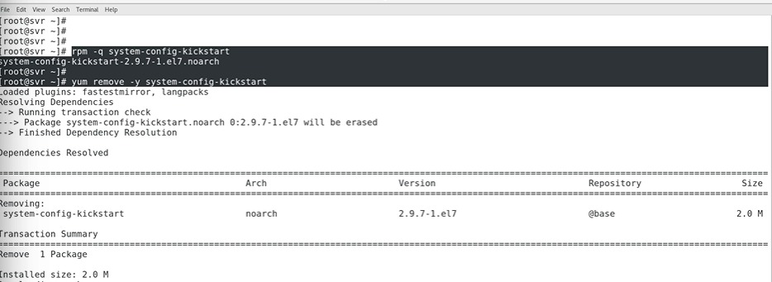

Slide 15
Yum information finger query info finger

Slide 16
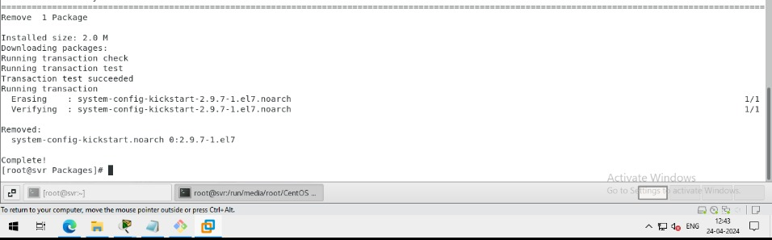
Removed the package yum

Slide 17
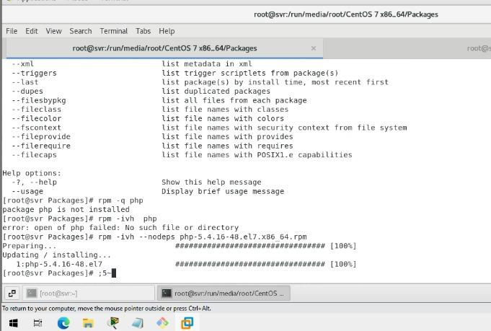
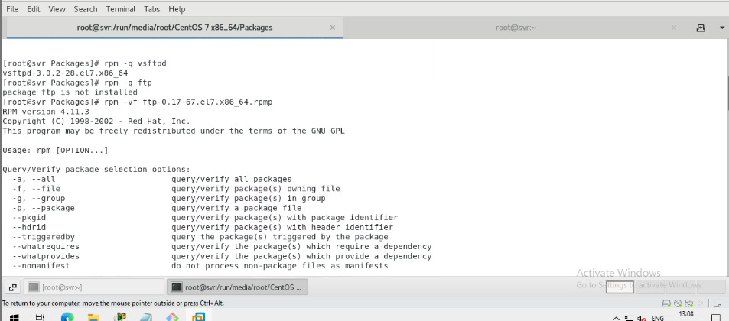
TASK :- Verify if these package are installed or not,then install the following packages using RPM. -vsftpd -ftp -telnet -php

Slide 18
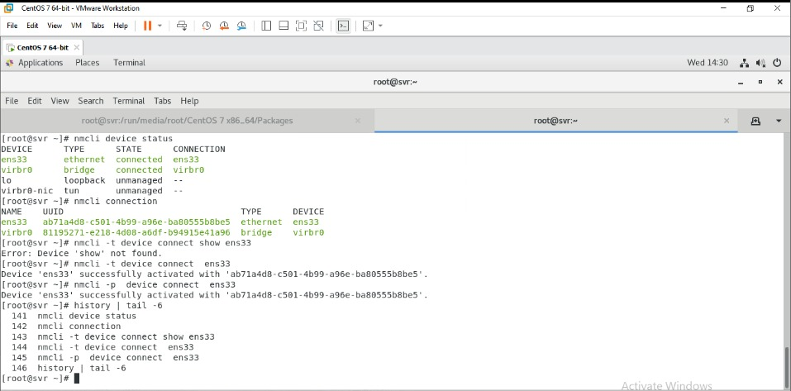
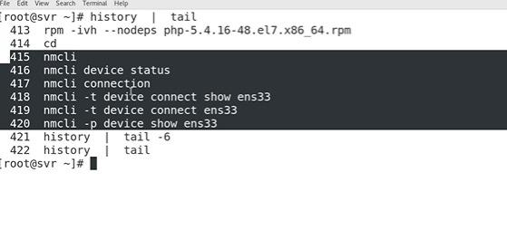
Network management ---------------------- CLI:- -nmcli -nmtui -ip address -ifconfig -/etc/sysconfig/network –scripts/ifcfg-ens33 2.GUI -Network settings
USE NMCLI:-
------------------

Slide 19
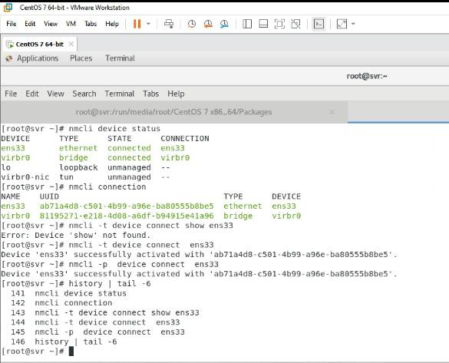
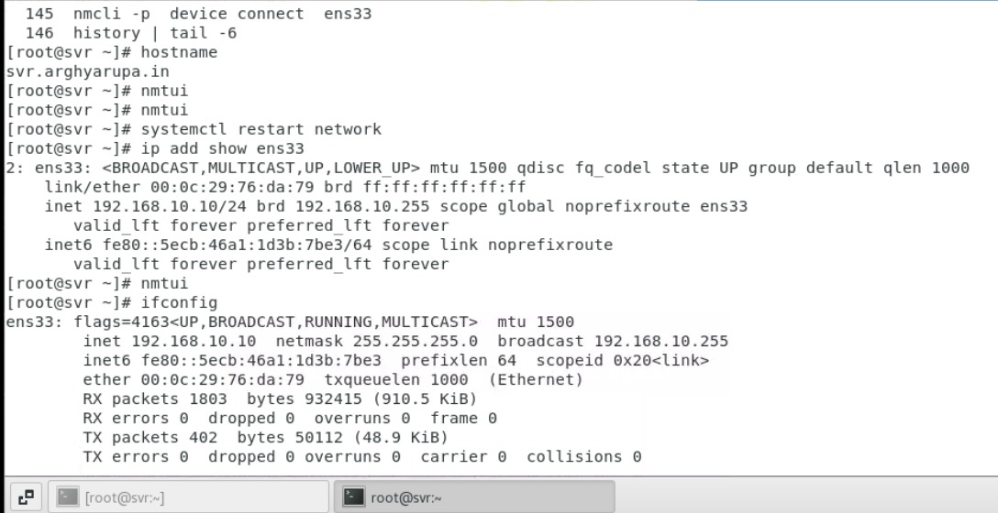
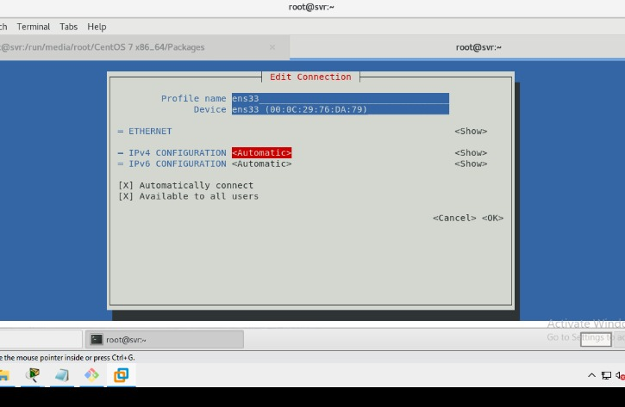
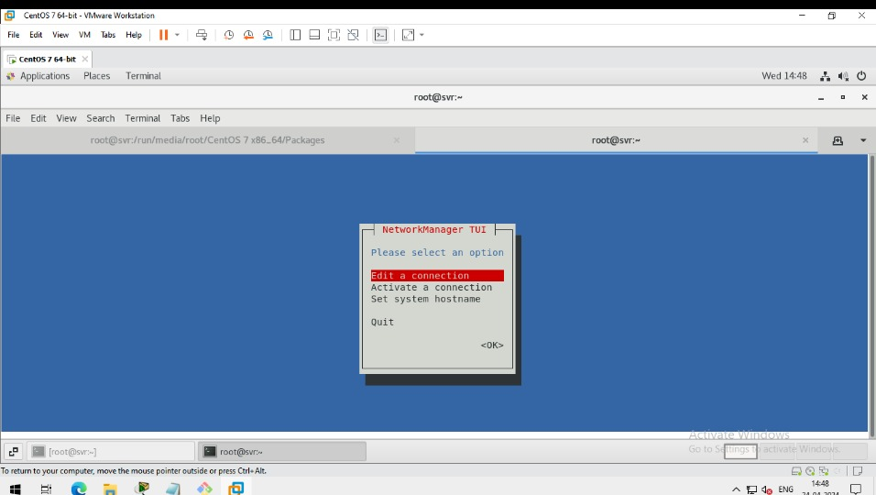
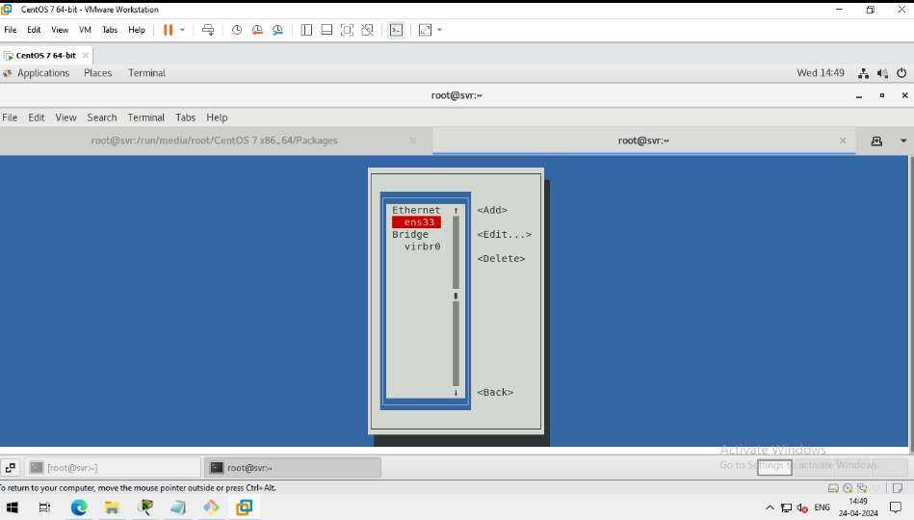
1.
2.
3.
4.
5.

Slide 20
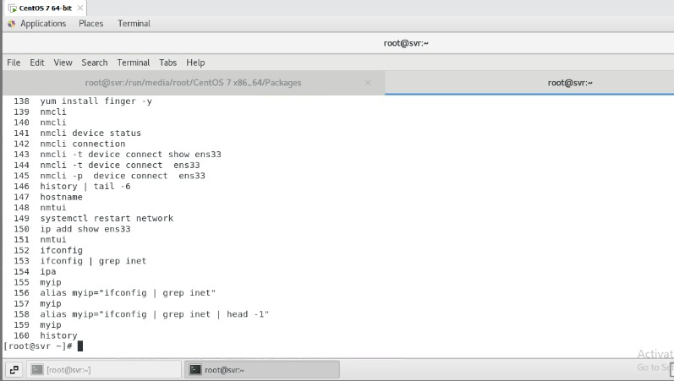
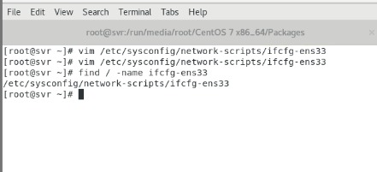

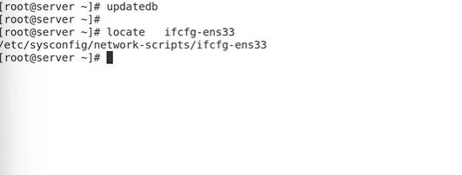
This is the temporary process ..
6.
7.
9. To Open the ens33 file write the cmd:-
8. To find the ifcfg enss33 type the command
10. Locate the command
-updatedb
-locate <filename>

Slide 21
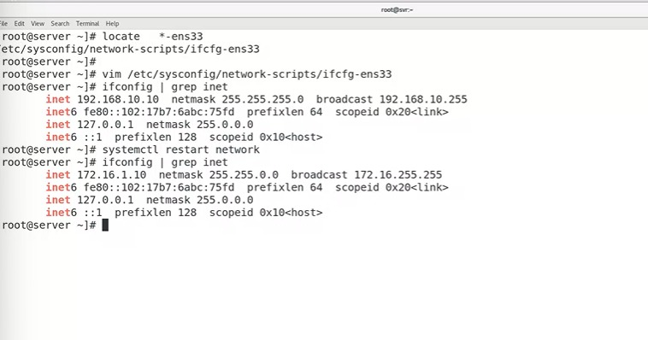
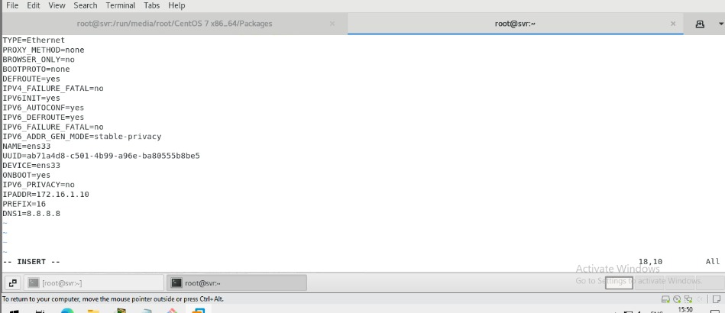
Hence The reason locate is faster than find is because it relies on a database that lists all the files on the filesystem. This database is usually updated once a day with a cron script, but you can update it manually with the updatedb command
•Change the ip address manually
•Type the command vim /etc/sysconfig/network-scripts/ifcfg-ens33
Open it and chnge the ip adress and save it and exit then restart it using cmd

Slide 22
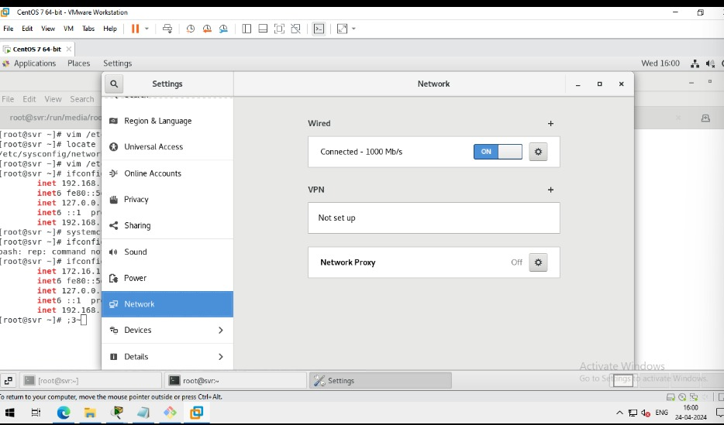
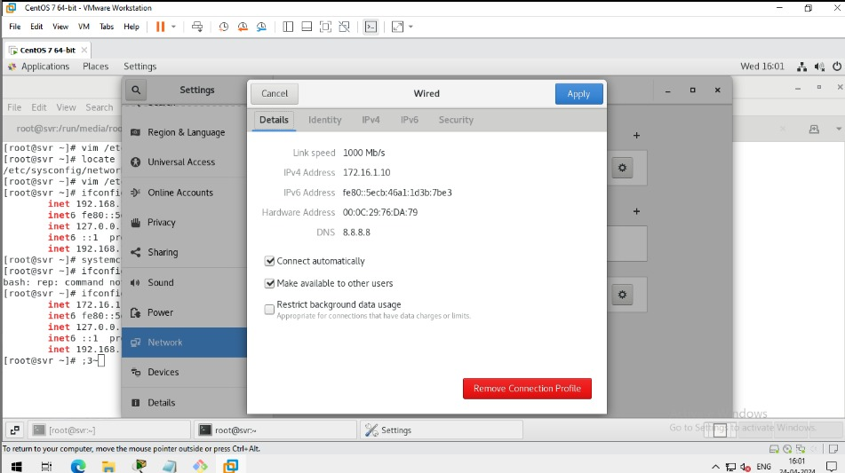
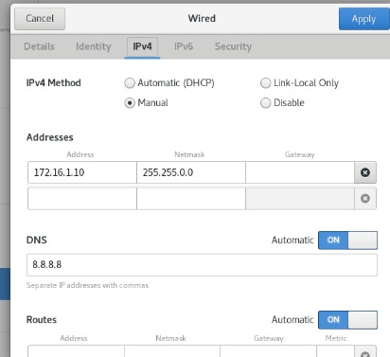
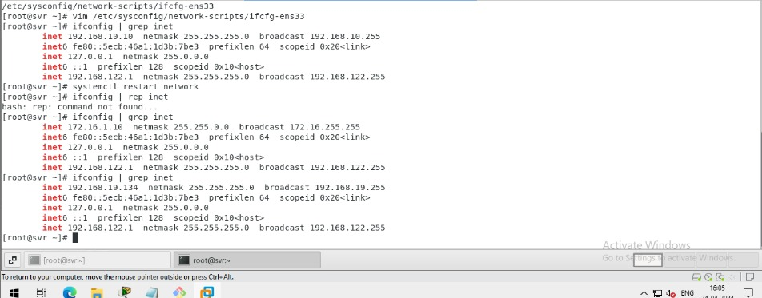
CHANGING OF GUI IP ADDRESS
•go to settings >go to network >open the wired settings> Go to ipv4 and make it automatically and apply it> then check it whether it work or not .to check it type the commands ifconfig | grep inet
1.
2.
3.
4.

Slide 23
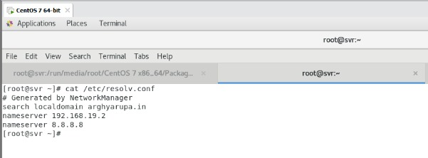
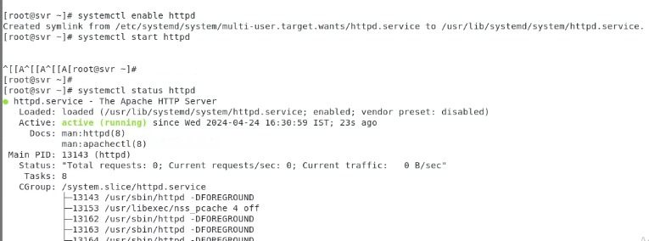
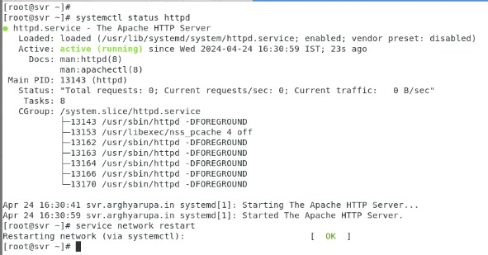
DNS files.uses
SERVICE MANAGEMENT :-
-MANAGE THE SERIVE ON LINIX MACHINE
-actipn:-
•start,stop,restart,enable,disable,isactive
-service name:-
•httpd,vsftpd,named,sshd
-old syntax:
•service <service-name> <action>
-new sysntax:
Systemctl enable httd

Slide 24
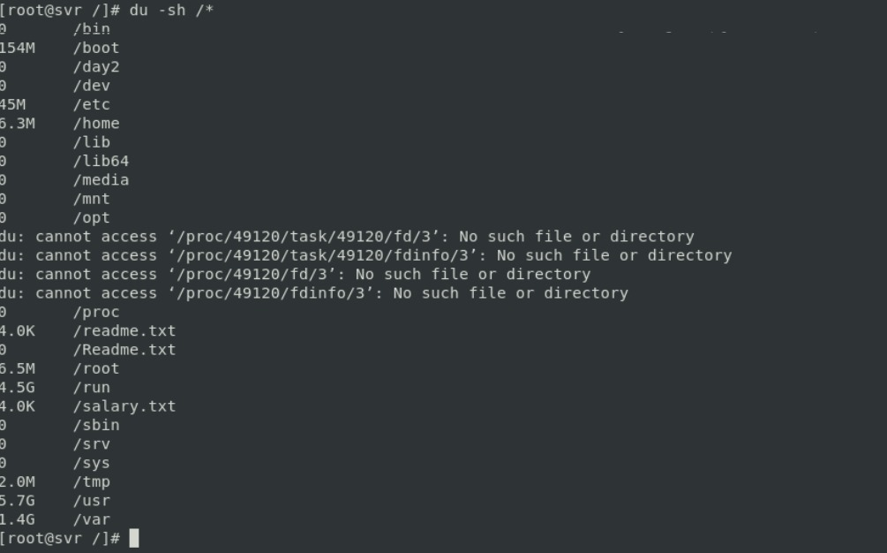
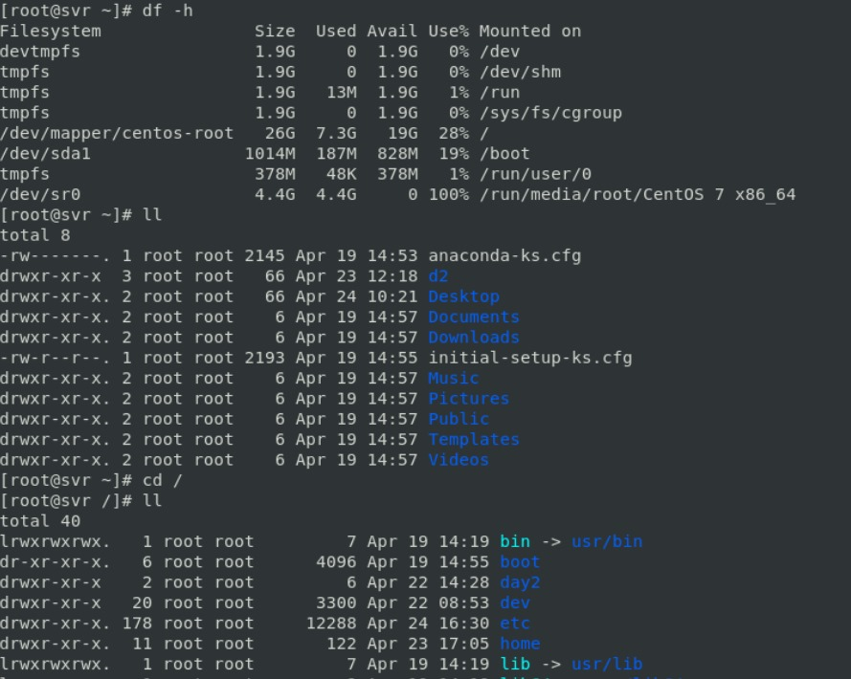
Storagr management –
-disk management
. Simple disk partitioning 2. LVM partitioning cmds: 1. df –h 2. dush /*
3.Lsblk
4.fdisk(fdisk –l /devlsda)
1.
2.

Slide 25
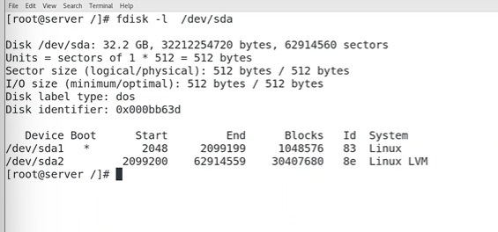
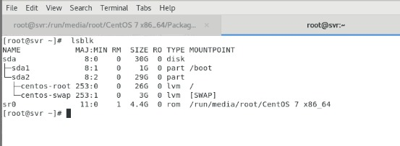
3.
4.
SIMPLE DISK PARTITION –
1.Add the disk to the Linux
2.Create the partition
3.Create the mount point
4.Create the file system
5.Mount the partition and verify
TO CREATE A NEW DISK:-
Go to linu machine and right click go to settings then click on add and

Slide 26
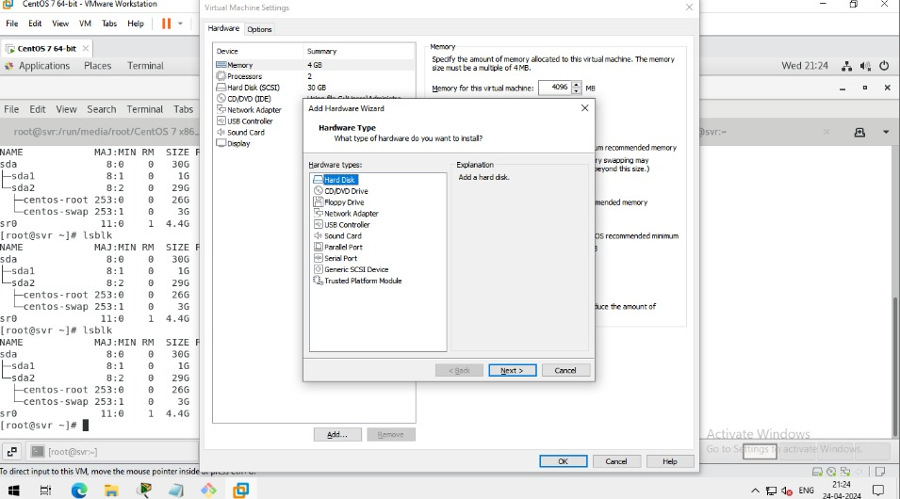
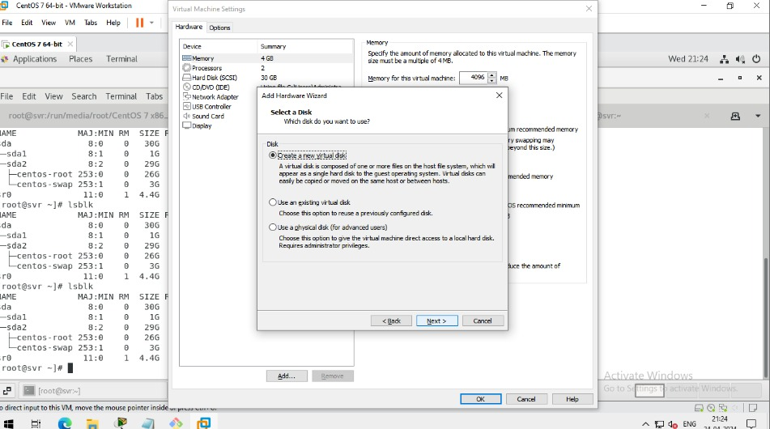
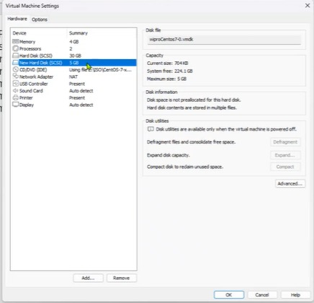
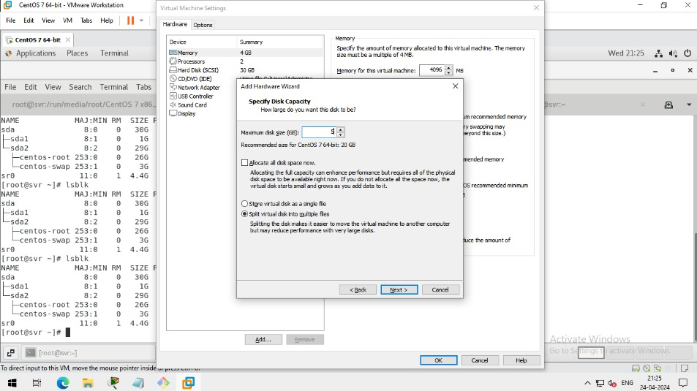
1.
2.
3.Change the hd size as 5.because it’s sufficient for our project
4.

Slide 27
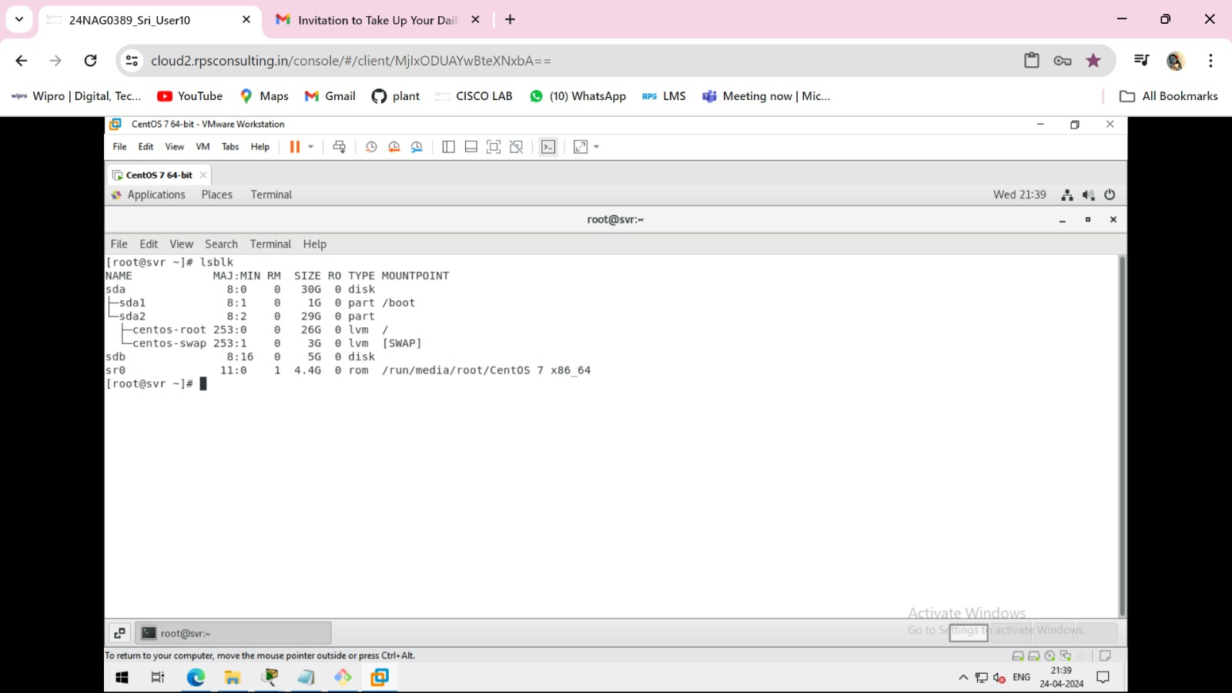

Now check that new disk is add or not to restart it type on terminal command init 6 to restart it and check it.

